Slide 1
Human Computer Interaction
Task Analysis
Imran Siddiqi
imran.siddiqi@gmail.com

Slide 2
Task Analysis
Process of analyzing the way people perform their jobs
  What they do?
  What things they work with?
  What they must know?
Task Analysis

Slide 3
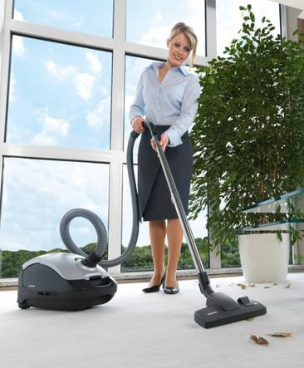
Task Analysis – An Example
In order to clean the house
  Get the vacuum cleaner out
  Fix the appropriate attachments
  Clean the rooms
  When the dust bag gets full, empty it
  Put the vacuum cleaner and tools away
Must know about:
  Vacuum cleaners, their attachments, dust bags, cupboards, rooms etc
Task Analysis

Slide 4
Approaches to Task Analysis
Task decomposition
  Splitting task into (ordered) subtasks
Knowledge based techniques
  What the user need to know about the task and how this knowledge is organized
Entity/object based analysis
  Relationships between objects, actions and the people
Task Analysis

Slide 5
Task Decomposition
Decompose the task into subtasks
Hierarchical Task Analysis - HTA
  Hierarchy of tasks and subtasks
  Plans
    In what order the subtasks are performed
    Under what conditions they are performed
Task Analysis

Slide 6
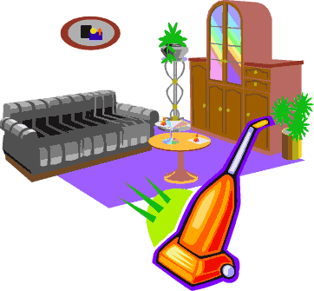
Textual HTA Description
0. in order to clean the house
1. get the vacuum cleaner out
2. get the appropriate attachment
3. clean the rooms
3.1. clean the hall
3.2. clean the living rooms
3.3. clean the bedrooms
4. empty the dust bag
5. put vacuum cleaner and attachments away
.
Plan 0: Do 1 - 2 - 3 - 5 in that order.
When the dust bag gets full do 4
Plan 3: Do any of 3.1, 3.2 or 3.3 in any order depending on which rooms need cleaning
Task Analysis

Slide 7
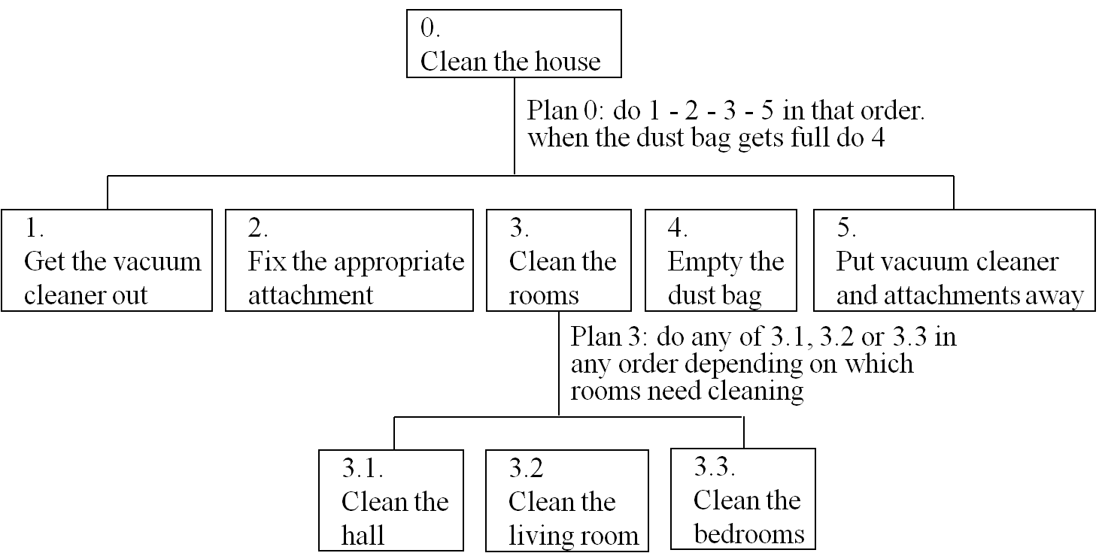
Diagrammatic Representation of HTA
Task Analysis

Slide 8
Generating the Hierarchy
Iterative Process
Task – Decompose into subtasks
  Direct observation, expert opinion
Stopping rules
  How do we know when to stop?
  Is “empty the dust bag” simple enough?
  Purpose: expand only relevant tasks
Task Analysis

Slide 9
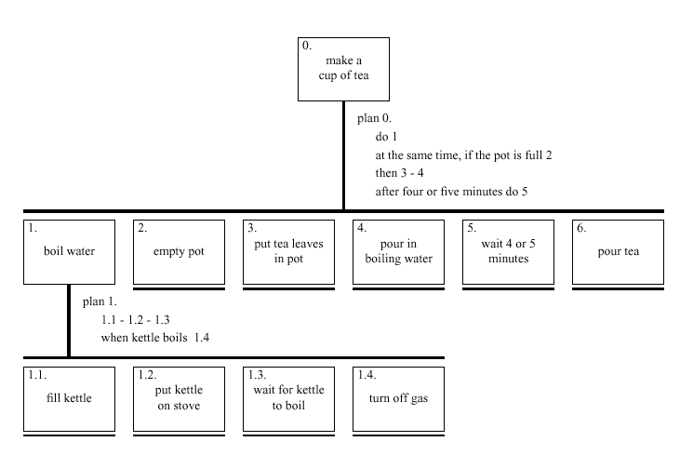
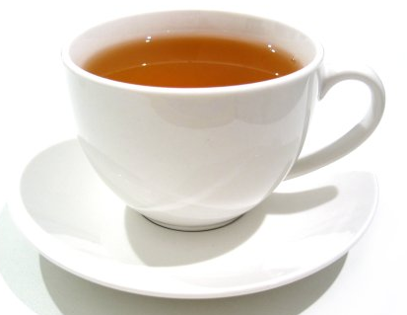
Making Tea
Plan 0
Do 1
At the same time, if the pot is full 2
Then 3 – 6
6
Task Analysis

Slide 10
Refining the Description
Given initial HTA (textual or diagram)
  How to check / improve it?
Some heuristics:
  Paired actions e.g., where is `turn on gas‘
  Restructure e.g., generate task `make pot‘
  Balance e.g., is `pour tea' simpler than making pot?
  Generalise e.g., make one cup ….. or more
Task Analysis

Slide 11
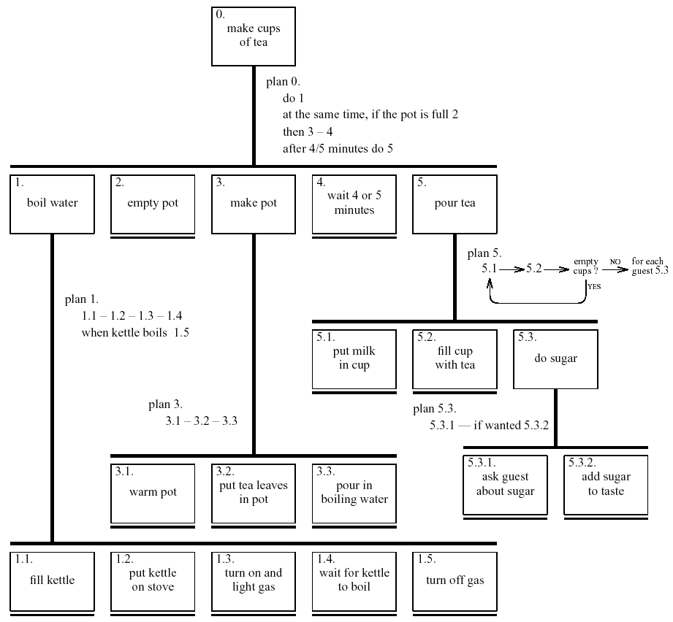
Refined HTA
Task Analysis

Slide 12
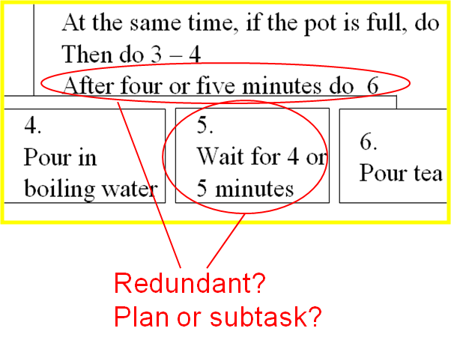
Handling Waiting
Is waiting part of a plan?
… or a task?
Task Analysis

Slide 13
Types of Plans
Fixed Sequence
  The same sequence of subtasks is always followed
    E.g. 1 then 2 then 3
Optional Subtasks
  Subtasks that may or may not be performed depending on circumstances
    E.g. If the pot is full …
Task Analysis

Slide 14
Types of Plans
Waiting-For Events
  Wait for a certain time
    E.g. Wait for 4 or 5 minutes in plan 0 in the HTA of tea making
  Wait for the occurrence of some event
    E.g. Wait for kettle to boil in plan 1 in the HTA of tea making
Cycles
  Repeat some subtasks until a condition is reached
    E.g. Repeatedly perform subtasks 5.1 – 5.3 until no more cup is left in the HTA of tea making
Task Analysis

Slide 15
Types of Plans
Time Sharing
  Some subtasks can be done at the same time
    E.g. Subtasks 1 and 2 can be done at the same time in the HTA of tea making
Discretionary Subtasks
  Whether to perform some subtasks is at the people’s discretion
    E.g. In plan 3 in the HTA of room cleaning, the person is allowed to clean any room that he/she thinks needs cleaning and in any order
Task Analysis

Slide 16
Types of Plans
Mixtures
  Most plans are a mixture of different types
    E.g. Plan 1 in the HTA of tea making is largely a fixed sequence but split by a wait
Task Analysis

Slide 17
Types of Plans
Fixed sequence - 1.1 then 1.2 then 1.3
Optional tasks - If the pot is full 2
Wait for events - When kettle boils 1.4
Cycles - Do 5.1 5.2 while there are still empty cups
Time-sharing - Do 1; at the same time ...
Discretionary - Do any of 3.1, 3.2 or 3.3 in any order
Mixtures - Most plans involve several of the above
Task Analysis

Slide 18

References
Chapter 15 - Human Computer Interaction by Dix et al.
Task Analysis

